Slide 1
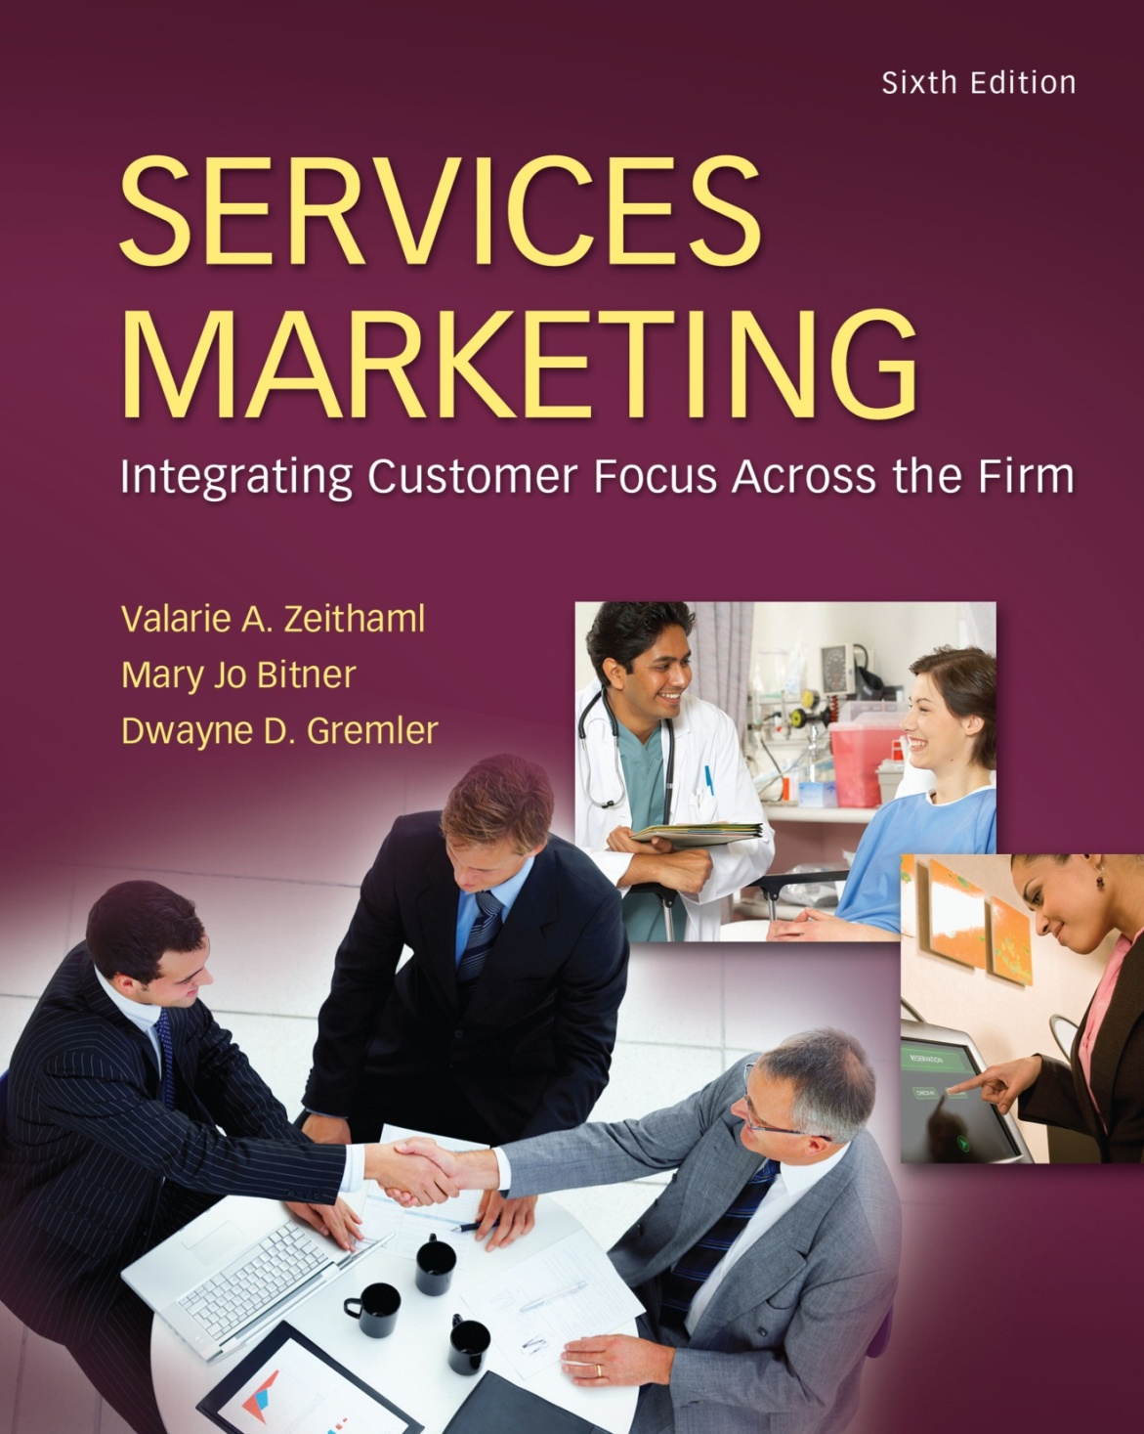
McGraw-Hill/Irwin
Copyright © 2013 by The McGraw-Hill Companies, Inc. All rights reserved.

Slide 2
Conceptual Framework of the Book: The Gaps Model of Service Quality
The Gap model of service quality was developed by Parasuraman, Berry and Zeithaml (1985), and more recently described in Zeithaml and Bitner (2003).
It has served as a framework for research in services marketing, including hospitality marketing, for over two decades.
The model identifies four specific gaps leading to a fifth overall gap between customers’ expectations and perceived service.

Slide 3
Conceptual Framework of the Book: The Gaps Model of Service Quality
Chapter
2
The Provider Gaps:
Gap 1 – The Listening Gap
not knowing what customers expect
Gap 2 – The Service Design and Standards Gap
not having the right service designs and standards
Gap 3 – The Service Performance Gap
not delivering to service standards
Gap 4 – The Communication Gap
not matching performance to promises
Putting It All Together: Closing the Gaps
2-3

Slide 4
Customers Have Expectations For Service Experiences And They Use Them To Measure Against The Perceived Service Performance In Their Judgment Of Service Quality. It Is Essential, Then, That Managers Determine What Those Expectations Are When Designing The Service
Conceptual Framework of the Book: The Gaps Model of Service Quality

Slide 5
Gaps Model of Service Quality
Customer Gap:
difference between customer expectations and perceptions
Provider Gap 1 (Listening Gap):
not knowing what customers expect
Provider Gap 2 (Service Design & Standards Gap):
not having the right service designs and standards
Provider Gap 3 (Service Performance Gap):
not delivering to service standards
Provider Gap 4 (Communication Gap):
not matching performance to promises
2-5

Slide 6
Provider Gap 1 (Listening Gap):
The first gap in service quality occurs when management fails to accurately identify customer expectations.
the difference in customer expectations and management’s perception of customer expectations
Hotel managers, for instance, must know and understand what their guests expect from their stay, including all tangibles (the room, amenities, lobby features) and intangible components (availability of additional services, ease of check-in and check-out procedures).
2-6

Slide 7
Provider Gap 1 (Listening Gap):
The size of the gap is dependent on:
the extent of upward communication (from customers to top management),
the number of layers of management,
the size of the organization, and most importantly, the extent of marketing research to identify customer expectations.
2-7

Slide 8
Gap 2 – The Service Design and Standards Gap
The second gap is referred to as the design gap.
It is measured by how well the service design specifications match up to management’s perception of customer expectations.
The extent of this gap is dependent on management’s belief that service quality is important and that it is possible, as well as the resources that are available for the provision of the service.
2-8

Slide 9
Gap 2 – The Service Design and Standards Gap
A restaurant manager may understand customer expectations for being served within 20 minutes of ordering, but may not have the resources or the appropriate number of staff to insure that speed of service.
2-9

Slide 10
Gap 3 – The Service Performance Gap
Gap 3 represents the variation in service design and service delivery. Known as the performance gap, its extent is a function of many variables involved in the provision of service.
Since individuals perform the service, the quality may be affected by such factors as skill level, type of training received, degree of role congruity (agreeability) or conflict, and job fit.
2-10

Slide 11
Gap 3 – The Service Performance Gap
Some service providers (i.e. waiters, front-desk staff) do not have a high service inclination, despite training. Service recovery efforts along with extent of responsibility and empowerment also affect the size of this gap.
2-11

Slide 12
Gap 3 – The Service Performance Gap
The process is further complicated by the customer’s participation in the service encounter.
A customer may make a special request for a room type different from the one originally reserved, or request a menu item after the initial order has been completed, making it more difficult to perform the service as intended.
2-12

Slide 13
Provider Gap 4 (Communication Gap):
The fourth gap is called the communications gap. It is the difference between what is promised to customers, either explicitly or implicitly, and what is being delivered.
Hospitality companies use advertising, personal selling, and sales promotion to inform, persuade, and remind guests about its products and services.
2-13

Slide 14
Provider Gap 4 (Communication Gap):
Showing beautifully appointed hotel rooms, refreshing swimming pools, and luxurious lobby areas in an advertisement communicates to the target customers.
The extent of communications between the company and the advertising agencies will affect the size of the gap.
Over-promising is commonly responsible for the communication gap. Each gap has a cumulative effect from the preceding gaps.
2-14

Slide 15
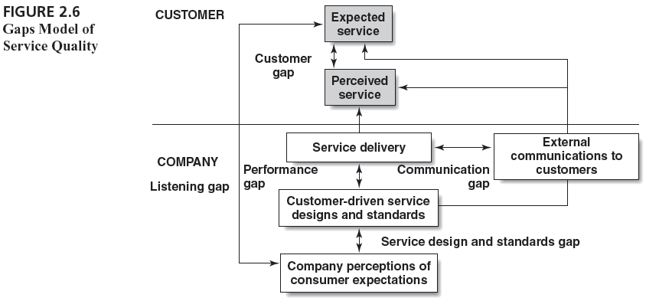
Gaps Model of Service Quality
2-15

Slide 16
Provider Gap 5 :
Gap 5 is the total accumulation of variation in Gaps 1 through 4 and represents the difference between expectations and perceived service.
Furthermore, consumers evaluate perceived service along five quality dimensions.
2-16

Slide 17
Ways to Use Gap Analysis
Overall Strategic Assessment:
How are we doing overall in meeting or exceeding customer expectations?
How are we doing overall in closing the four company gaps?
Which gaps represent our strengths and where are our weaknesses?
2-17

Slide 18
Ways to Use Gap Analysis
Specific Service Implementation
Who is the customer? What is the service?
Are we consistently meeting/exceeding customer expectations with this service?
If not, where are the gaps and what changes are needed? (Examine gaps 1-4 for this particular service.)
2-18

Slide 19
Dimensions of service quality
Service quality dimensions refer to the psychological dimensions that form the basis of a customer’s perceived quality of a service.
2-19

Slide 20
Dimensions of service quality
While numerous marketing researchers have attempted to define the specific dimensions of service quality, Parasuraman, Berry, and Zeithaml (1985) introduced the definition in their presentation of the Gap Model of Service Quality.
2-20

Slide 21
Dimensions of service quality
They proposed that five specific dimensions of service quality exist and apply regardless of the service industry: reliability, responsiveness, assurance, empathy, and tangibles.
2-21

Slide 22
Dimensions of service quality
Reliability is defined as the ability to perform the promised service dependably and accurately. In other words, it means doing what you say you will do.
Customers have consistently stated that a company’s ability to deliver promises is the most vital factor to providing service quality.
Having a room ready upon check-in is an example of the reliability dimension.
2-22

Slide 23
Dimensions of service quality
Responsiveness is the willingness to help customers and to provide prompt service.
Customers judge a company’s responsiveness by assessing the amount of time it takes and the attentiveness that is offered in response to their requests, questions, complaints, and problems.
2-23

Slide 24
Dimensions of service quality
Companies that use automated phone systems, regularly put customers on hold, or consistently have long wait times or long lines tend to be rated low on the responsiveness dimension.
Responding quickly to requests or complaints leads to a higher rating on this dimension.
2-24

Slide 25
Dimensions of service quality
The third dimension of service quality is assurance. Assurance is defined as employees’ knowledge and courtesy and the ability of the firm and its employees to inspire trust and confidence.
The assurance dimension is particularly important in service industries offering high levels of credence qualities, such as auto repair and medical services.
2-25

Slide 26
Dimensions of service quality
The importance of the assurance dimension increases in proportion to the risk, and the greater the inability for a customer to evaluate the service.
The expertise of an endorser or a particular service provider for a cruise vacation may affect the level of confidence and trust a customer has toward that service.
2-26

Slide 27
Dimensions of service quality
Empathy is defined as the caring, individualized attention the firm provides its customers.
Customers perceive the level of a company’s empathy by the degree of personalized service offered.
Customers want to be known on an individual basis and feel that the company understands and addresses their individual needs.
2-27

Slide 28
Dimensions of service quality
When competing with companies that enjoy economies of scale, small companies can earn greater market shares by focusing on empathy.
Showing concern for a guest whose luggage is lost is a way to improve the overall perceived service quality.
2-28

Slide 29
Dimensions of service quality
The final dimension of service quality is tangibles.
Tangibles are defined as the appearance of physical facilities, equipment, personnel and communication materials.
Service industries such as hotels and restaurants rely heavily on tangibles.
Guests often judge the quality of a hotel experience on the quality of the physical environment and tangible amenities.
2-29

Slide 30
Technology’s Impact on the Gaps Model of Service Quality
Technology, in particular information technology, has influenced the nature of services themselves, how they are delivered, and the practice of service innovation and service management.
Here we overview just a few of these basic changes and trends by identifying some key themes.
2-30

Slide 31
Technology’s Impact on the Gaps Model of Service Quality
Inspiring Service Innovation Technology has been a basic force behind many service innovations now taken for granted, such as automated voice mail, interactive voice response systems, Internet-based services, and various smart services—for example the “connected car,” smart meters for monitoring energy consumption, and remote health monitoring services.
2-31

Slide 32
Technology’s Impact on the Gaps Model of Service Quality
Internet-based companies like Amazon, e-Bay, and Second Life have sprung up, offering radically new services for consumers. And, established companies have developed brand new services based on information technology.
2-32

Slide 33
Technology’s Impact on the Gaps Model of Service Quality
For example, the Wall Street Journal offers an interactive edition that allows customers to organize the newspaper’s content to suit their individual preferences and needs.
2-33

Slide 34
Technology’s Impact on the Gaps Model of Service Quality
Advances in information technology are also making it possible for entire suites of services including phone, Internet, video, photography, and e-mail to be available through one device such as the iPhone and similar products.
2-34

Slide 35
Technology’s Impact on the Gaps Model of Service Quality- Providing Options for Service Delivery
Technology is also providing new opportunities for delivering existing services in more accessible, convenient, and productive ways. Technology facilitates basic customer service functions (bill paying, answering questions, checking account records, tracking orders), purchase transactions (both retail and business-to-business), and learning or information seeking.
2-35

Slide 36
Technology’s Impact on the Gaps Model of Service Quality
Over the past few decades, companies have moved from face-to-face service to telephone-based service to widespread use of interactive voice response systems to Internet-based customer service and now to wireless service.
Technology also facilitates transactions by offering a direct vehicle for making purchases and conducting businesses.
2-36

Slide 37
Technology’s Impact on the Gaps Model of Service Quality
Finally, technology provides an easy way for customers to learn, do research, and collaborate with each other. Access to information has never been easier.
For example, more than 20,000 websites currently offer health-related information, resulting in consumers having increasing involvement in their health decisions and care.
2-37

Slide 38
Technology’s Impact on the Gaps Model of Service Quality- Enabling Customers and Employees
Technology enables both customers and employees to be more effective and productive in receiving and providing service. Through self-service technologies, customers can now serve themselves more effectively.
2-38

Slide 39
Technology’s Impact on the Gaps Model of Service Quality- Enabling Customers and Employees
Via online banking, for Technology’s Impact on the Gaps Model of Service Quality for example, customers can access their accounts, check balances, apply for loans, and take care of just about any banking need they might have—all without the assistance of the bank’s employees.
2-39

Slide 40
Technology’s Impact on the Gaps Model of Service Quality- Expanding Global Reach
Technology also results in the potential for reaching out to customers around the globe in ways not possible when, in the not-so-distant past, services were limited to local provision.
The Internet itself knows no boundaries, and therefore information, customer service, and transactions can move across countries and across continents, reaching any customer who has access to the Web.
2-40

Slide 41
Technology’s Impact on the Gaps Model of Service Quality- Expanding Global Reach
Technology also allows employees of international companies to stay in touch easily—to share information and serve on virtual work teams together, thus allowing employees to work remotely and services to be provided by global workers.
2-41

Slide 42
The Dark Side of Service and Technology
Legitimate customer concerns over privacy and confidentiality raise issues for firms as they seek to learn about and interact with their customers online.
Research on “technology readiness” suggests that some customers are simply not interested in or ready to use technology (Parasuraman and Colby, 2001).
2-42

Slide 43
The Dark Side of Service and Technology
Employees can also be reluctant to accept and integrate technology into their work lives for a variety of reasons, including job insecurity and reluctance to embrace change.
Finally, from a company perspective, the payback in technology investments is often uncertain and the need to balance technology and human touch in developing relationships with customers can be challenging.
Technology-delivered service is not always the best answer.
2-43

