Slide 1
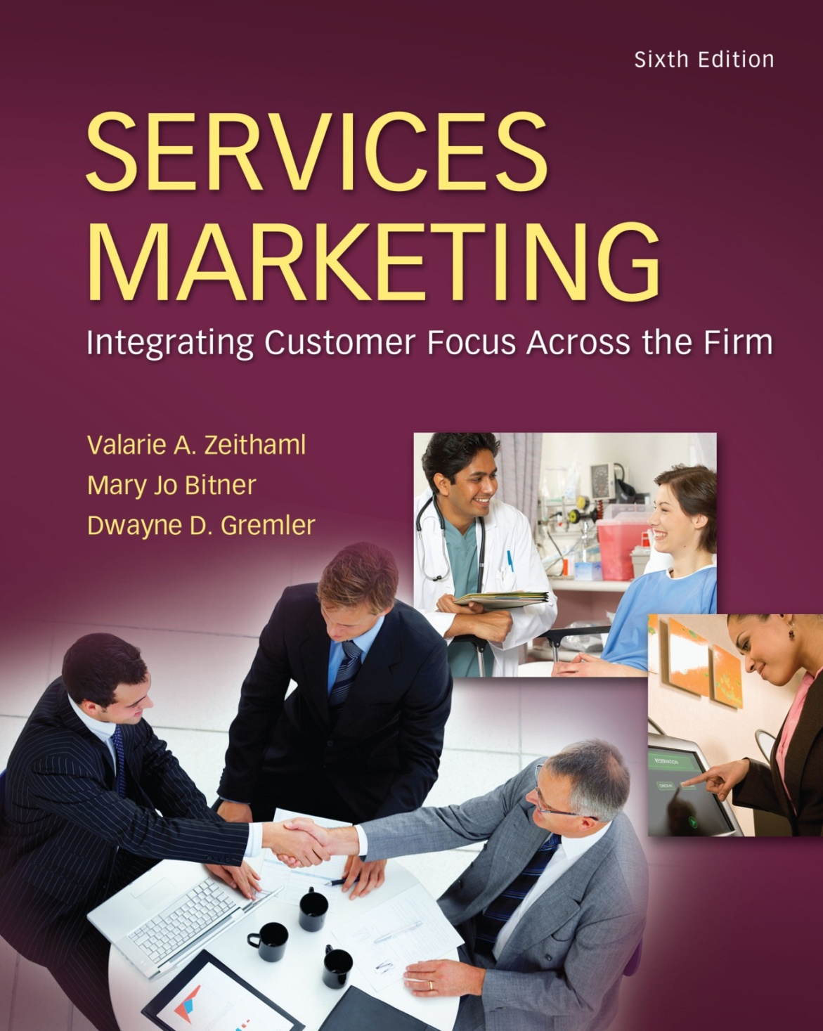
McGraw-Hill/Irwin
Copyright © 2013 by The McGraw-Hill Companies, Inc. All rights reserved.

Slide 2
Customer Expectations of Service
Chapter
3
Service Expectations
Factors that Influence Customer Expectations of Service
Issues Involving Customers’ Service Expectations
3-2

Slide 3
Objectives for Chapter 3: Consumer Expectations of Service
Recognize that customers hold different types of expectations for service performance.
Discuss several sources of customer expectations of service.
Delineate some important issues surrounding customer expectations.
3-3

Slide 4
Objectives for Chapter 3: Consumer Expectations of Service
Virgin Trains is a brand that has had the major challenge of bringing the UK rail industry into the twentieth century. The company is responsible for linking towns and cities across the length and breadth of the country with over 35 million passenger journeys each year.
It has therefore undertaken a significant level of marketing research to identify what people expect from train travel.
3-4

Slide 5
Objectives for Chapter 3: Consumer Expectations of Service
Many passengers have now had the experience of travelling on airlines or on overseas railways and as a result their expectations from long-distance train travel have increased. The research has highlighted the significant and highly diverse expectations that customers have of train travel.
No longer is a seat and access to toilets and basic refreshments acceptable; passengers now expect – demand even – a choice of on-board meals, health-conscious snacks, reading material and entertainment.
3-5

Slide 6
Objectives for Chapter 3: Consumer Expectations of Service
Business, and increasingly leisure, travellers also want access to the Internet and emails through on-board wireless Internet and the opportunity to use and charge their laptop and mobile.
This clearly demonstrates that customer expectations of service performance do not remain constant.
Organizations need to be aware of how these expectations are changing and adapt their service offering accordingly
3-6

Slide 7
Objectives for Chapter 3: Consumer Expectations of Service
Business, and increasingly leisure, travellers also want access to the Internet and emails through on-board wireless Internet and the opportunity to use and charge their laptop and mobile.
This clearly demonstrates that customer expectations of service performance do not remain constant.
Organizations need to be aware of how these expectations are changing and adapt their service offering accordingly
3-7

Slide 8
Objectives for Chapter 3: Consumer Expectations of Service
Customer expectations are beliefs about service delivery that serve as standards or reference points against which performance is judged.
Because customers compare their perceptions of performance with these reference points when evaluating service quality, thorough knowledge about customer expectations is critical to services marketers.
3-8

Slide 9
Objectives for Chapter 3: Consumer Expectations of Service
Knowing what the customer expects is the first and possibly most critical step in delivering good quality service.
Being wrong about what customers want can mean losing a customer’s business when another company hits the target exactly.
Being wrong can also mean expending money, time and other resources on things that do not count to the customer.
Being wrong can even mean not surviving in a fiercely competitive market.
3-9

Slide 10
Objectives for Chapter 3: Consumer Expectations of Service
Successful services marketing are the following:
What types of expectation standards do customers hold about services?
What factors most influence the formation of these expectations? What role do these factors play in changing expectations?
How can a service company meet or exceed customer expectations?
3-10

Slide 11
Meaning and types of service expectations
The level of expectation can vary widely depending on the reference point the customer holds.
Although most everyone has an intuitive sense of what expectations are, service marketers need a far more thorough and clear definition of expectations in order to comprehend, measure and manage them.
Let us imagine that you are planning to go to a restaurant.
On the left of the continuum are different types or levels of expectations, ranging from high (top) to low (bottom).
At each point we give a name to the type of expectation and illustrate what it might mean in terms of a restaurant you are considering
3-11

Slide 12
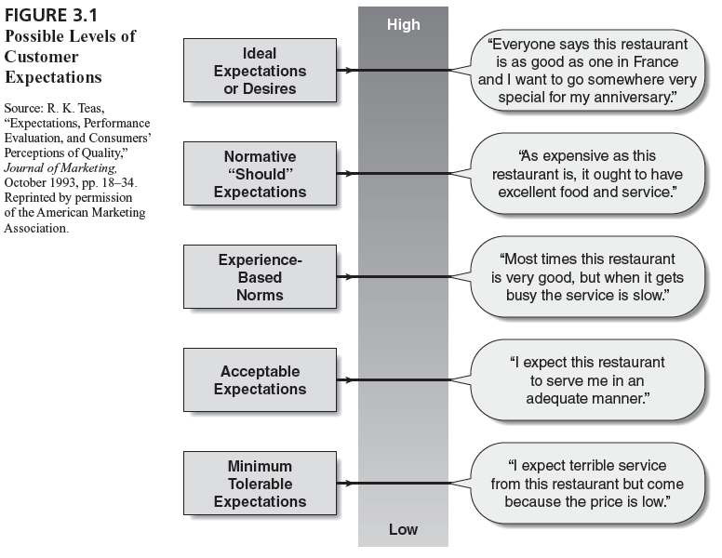
Possible Levels of Customer Expectations
3-12

Slide 13
Meaning and types of service expectations
Note how important the expectation you held will be to your eventual assessment of the restaurant’s performance.
Suppose you went into the restaurant for which you held the minimum tolerable expectation, paid very little money and were served immediately with good food.
Next suppose that you went to the restaurant for which you had the highest (ideal) expectations, paid a lot of money and were served good (but not fantastic) food.
Which restaurant experience would you judge to be best?
The answer is likely to depend a great deal on the reference point that you brought to the experience.
3-13

Slide 14
Dual Customer Expectation Levels
Customers hold different types of expectations about service. We can focus on two types.
The highest can be termed desired service: the level of service the customer hopes to receive – the ‘wished for’ level of performance.
Desired service is a blend of what the customer believes ‘can be’ and ‘should be’.
For example, consumers who sign up for a computer dating service expect to find compatible, attractive, interesting people to date and perhaps even someone to marry.
3-14

Slide 15
Dual Customer Expectation Levels
The expectation reflects the hopes and wishes of these consumers; without these hopes and wishes and the belief that they may be fulfilled, consumers would probably not purchase the dating service.
3-15

Slide 16
Dual Customer Expectation Levels
Not all airlines or hotels you may be interested in may have a relationship with Expedia.com
In this situation and in general, customers hope to achieve their service desires but recognize that this is not always possible.
We call the threshold level of acceptable service adequate service – the level of service the customer will accept.
Adequate service represents the ‘minimum tolerable expectation’, the bottom level of performance acceptable to the customer.
Figure 3.2 shows these two expectation standards as the upper and lower boundaries for customer expectations. This figure portrays the idea that customers assess service performance on the basis of two standard boundaries: what they desire and what they deem acceptable
3-16

Slide 17
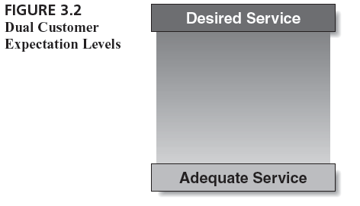
Dual Customer Expectation Levels
3-17

Slide 18
Dual Customer Expectation Levels
Levels of expectation are why two organizations in the same business can offer far different levels of service and still keep customers happy.
It is why McDonald’s can extend excellent industrialized service with few employees per customer and why an expensive restaurant with many tuxedoed waiters may be unable to do as well from the customer’s point of view.
A customer’s desired service expectation for fast-food restaurants is quick, convenient, tasty food in a clean setting.
The desired service expectation for an expensive restaurant, on the other hand, usually involves elegant surroundings, gracious employees, candlelight and fine food.
3-18

Slide 19
Dual Customer Expectation Levels
The adequate service expectation level, on the other hand, may vary for different firms within a category or subcategory.
Within fast-food restaurants, a customer may hold a higher expectation for McDonald’s than for Burger King, having experienced consistent service at McDonald’s over time and somewhat inconsistent service at Burger King.
It is possible, therefore, that a customer can be more disappointed with service from McDonald’s than from Burger King even though the actual level of service at McDonald’s may be higher than the level at Burger King.
3-19

Slide 20
The Zone of Tolerance
Services are heterogeneous in that performance may vary across providers, across employees from the same provider, and even with the same service employee.
The extent to which customers recognize and are willing to accept this variation is called the zone of tolerance.
If service drops below adequate service – the minimum level considered acceptable – customers will be frustrated and their satisfaction with the company will be undermined.
If service performance is higher than the zone of tolerance at the top end – where performance exceeds desired service – customers will be very pleased and probably quite surprised as well.
3-20

Slide 21
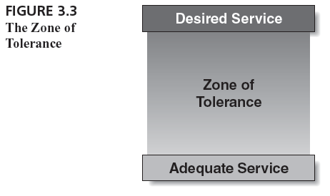
The Zone of Tolerance
3-21

Slide 22
The Zone of Tolerance
As an example, consider the service at a checkout queue in a grocery store. Most customers hold a range of acceptable times for this service encounter – probably somewhere between five and 10 minutes.
If service consumes that period of time, customers probably do not pay much attention to the wait.
If a customer enters the line and finds sufficient checkout personnel to serve him or her in the first two or three minutes, he or she may notice the service and judge it as excellent.
On the other hand, if a customer has to wait in line for 15 minutes, he or she may begin to grumble and look at his or her watch. The longer the wait is below the zone of tolerance, the more frustrated the customer becomes.
3-22

Slide 23
The Zone of Tolerance
This example shows that the marketer must understand not just the size and boundary levels for the zone of tolerance but also when and how the tolerance zone fluctuates with a given customer.
3-23

Slide 24
Different customers possess different zones of tolerance
Different customers possess different tolerance zones.
Some customers have narrow zones of tolerance, requiring a tighter range of service from providers, whereas other customers allow a greater range of service. For example, very busy customers would likely always be pressed for time, desire short wait times in general and hold a constrained range for the length of acceptable wait times.
When it comes to meeting plumbers or repair personnel at their home for problems with domestic appliance, customers who work outside the home have a more restricted window of acceptable time duration for that appointment than do customers who work in their homes or do not work at all.
3-24

Slide 25
Different customers possess different zones of tolerance
An individual customer’s zone of tolerance increases or decreases depending on a number of factors, including company-controlled factors such as price.
When prices increase, customers tend to be less tolerant of poor service.
In this case, the zone of tolerance decreases because the adequate service level shifts upward.
3-25

Slide 26
Zones of tolerance vary for service dimensions
In general, customers are likely to be less tolerant about unreliable service (broken promises or service errors) than other service deficiencies, which means that they have higher expectations for this factor.
We can express the boundaries of customer expectations of service with two different levels of expectations: desired service and adequate service.
The desired service level is less subject to change than the adequate service level.
A zone of tolerance separates these two levels. This zone of tolerance varies across customers and expands or contracts with the same customer.
3-26

Slide 27
Sources of desired service expectations
The two largest influences on desired service level are personal needs and philosophies about service.
Personal needs, those states or conditions essential to the physical or psychological well-being of the customer, are pivotal factors that shape what customers desire in service.
Personal needs can fall into many categories, including physical, social, psychological and functional.
A cinema-goer who regularly goes to see films straight from work, and is therefore thirsty and hungry, hopes and desires that the food and drink counters at the cinema will have short queues and attentive staff, whereas a cinema-goer who regularly has dinner elsewhere has a low or zero level of desired service from the food and drink counters.
3-27

Slide 28
Sources of desired service expectations
A customer with high social and dependency needs may have relatively high expectations for a hotel’s ancillary services, hoping, for example, that the hotel has a bar with live music and dancing.
Lasting service intensifiers are individual, stable factors that lead the customer to a heightened sensitivity to service.
One of the most important of these factors can be called derived service expectations, which occur when customer expectations are driven by another person or group of people.
A niece from a big family who is planning a ninetieth birthday party for a favourite aunt is representing the entire family in selecting a restaurant for a successful celebration. Her needs are driven in part by the derived expectations from the other family members.
3-28

Slide 29
Sources of desired service expectations
Another lasting service intensifier is personal service philosophy – the customer’s underlying generic attitude about the meaning of service and the proper conduct of service providers.
If you have ever been employed as a member of waiting staff in a restaurant, you are likely to have standards for restaurant service that were shaped by your training and experience in that role.
You might, for example, believe that waiters should not keep customers waiting longer than 15 minutes to take their orders. Knowing the way a kitchen operates, you may be less tolerant of lukewarm food or errors in the order than customers who have not held the role of waiter or waitress.
In general, customers who are themselves in service businesses or have worked for them in the past seem to have especially strong service philosophies.
3-29

Slide 30
Sources of adequate service expectations
A different set of determinants affects adequate service, the level of service the customer finds acceptable.
Influence adequate service: (1) temporary service intensifiers, (2) perceived service alternatives, (3) customer self-perceived service role, (4) situational factors, and (5) predicted service.
The first set of elements, temporary service intensifiers, consists of short-term, individual factors that make a customer more aware of the need for service.
Personal emergency situations in which service is urgently needed (such as an accident and the need for car insurance or a breakdown in office equipment during a busy period) raise the level of adequate service expectation, particularly the level of responsiveness required and considered acceptable.
3-30

Slide 31
Sources of adequate service expectations
Perceived service alternatives are other providers from whom the customer can obtain service.
An airline customer who lives in a provincial town with a small airport, for example, has a reduced set of options in airline travel.
This customer will be more tolerant of the service performance of the carriers in the town because few alternatives exist.
He or she will accept the scheduling and lower levels of service more than will the customer in a big city who has myriad flights and airlines to choose from.
In general, service marketers must discover the alternatives that the customer views as comparable rather than those in the company’s competitive set.
3-31

Slide 32
Sources of adequate service expectations
A third factor affecting the level of adequate service is the customer’s self-perceived service role.
We define this as customer perceptions of the degree to which customers exert an influence on the level of service they receive.
In other words, customers’ expectations are partly shaped by how well they believe they are performing their own roles in service delivery.
The customer’s active participation in the service also affects this factor. A customer who does not get his or her car serviced regularly is likely to be more lenient on the car manufacturer when he or she experiences problems than one who conscientiously follows the manufacturers service schedules.
3-32

Slide 33
Sources of adequate service expectations
Levels of adequate service are also influenced by situational factors, defined as service performance conditions that customers view as beyond the control of the service provider.
For example, where personal emergencies such as serious car accidents would likely intensify customer service expectations of insurance companies (because they are temporary service intensifiers), catastrophes that affect a large number of people at one time (floods or storms) may lower service expectations because customers recognize that insurers are inundated with demands for their services.
Customers who recognize that situational factors are not the fault of the service company may accept lower levels of adequate service given the context.
3-33

Slide 34
Sources of adequate service expectations
The final factor that influences adequate service is predicted service, the level of service that customers believe they are likely to get.
This type of service expectation can be viewed as predictions made by customers about what is likely to happen during an impending transaction or exchange.
For example, travellers may expect poorer service from some of the no-frills airlines such as Ryanair or easyJet in comparison to some of the full-cost airlines (British Airways, Air France)
3-34

Slide 35
Sources of both desired and predicted service expectations
When consumers are interested in purchasing services, they are likely to seek or take in information from several different sources. For example, they may call a store, ask a friend or deliberately track newspaper advertisements to find the needed service at the lowest price.
This section discusses one internal and three external factors that influence both desired service and predicted service expectations: (1) explicit service promises, (2) implicit service promises, (3) word-of-mouth communications and (4) past experience.
3-35

Slide 36
Sources of both desired and predicted service expectations
Explicit service promises are personal and non-personal statements about the service made by the organization to customers.
The statements are personal when they are communicated by salespeople or service or repair personnel; they are non-personal when they come from advertising, brochures and other written publications.
Explicit service promises are one of the few influences on expectations that are completely in the control of the service provider
3-36

Slide 37
Sources of both desired and predicted service expectations
Implicit service promises are service-related cues other than explicit promises that lead to inferences about what the service should and will be like.
These quality cues are dominated by price and the tangibles associated with the service.
In general, the higher the price and the more impressive the tangibles, the more a customer will expect from the service.
Consider a customer who shops for insurance, finding two firms charging radically different prices. He or she may infer that the firm with the higher price should and will provide higher-quality service and better coverage.
Similarly, a customer who stays at a five-star hotel is likely to desire and predict a higher standard of service than from a hotel with less impressive facilities
3-37

Slide 38
Sources of both desired and predicted service expectations
The importance of word-of-mouth communication in shaping expectations of service is well documented.
These personal and sometimes non-personal statements made by parties other than the organization convey to customers what the service will be like and influence both predicted and desired service.
Word-of-mouth communication carries particular weight as an information source because it is perceived as unbiased.
Word of mouth tends to be very important in services that are difficult to evaluate before purchase and before direct experience of them.
Experts (including consumer reports, friends and family) are also word-of-mouth sources that can affect the levels of desired and predicted service.
3-38

Slide 39
Sources of both desired and predicted service expectations
Past experience, the customer’s previous exposure to service that is relevant to the focal service, is another force in shaping predictions and desires. The service relevant for prediction can be previous exposure to the focal firm’s service. For example, you probably compare each stay in a particular hotel with all previous stays in that hotel.
First, managers need to know the pertinent expectation sources and their relative importance for a customer population, a customer segment and, perhaps, even a particular customer.
Second, they need to know, for instance, the relative weight of word of mouth, explicit service promises and implicit service promises in shaping desired service and predicted service.
3-39

Slide 40
Sources of both desired and predicted service expectations
Some of these sources are more stable and permanent in their influence (such as lasting service intensifiers and personal needs) than the others, which fluctuate considerably over time (like perceived service alternatives and situational factors).
3-40

Slide 41
Explicit service promises
Make realistic and accurate promises that reflect the service actually delivered rather than an idealized version of the service.
Ask contact people for feedback on the accuracy of promises made in advertising and personal selling.
Avoid engaging in price or advertising wars with competitors because they take the focus off customers and escalate promises beyond the level at which they can be met.
Formalize service promises through a service guarantee that focuses company employees on the promise and that provides feedback on the number of times promises are not fulfilled.
3-41

Slide 42
Implicit service promises
Ensure that service tangibles accurately reflect the type and level of service provided.
Ensure that price premiums can be justified by higher levels of performance by the company on important customer attributes.
3-42

Slide 43
Lasting service intensifiers
Use market research to determine sources of derived service expectations and their requirements.
Focus advertising and marketing strategy on ways the service allows the focal customer to satisfy the requirements of the influencing customer.
Use market research to profile personal service philosophies of customers and use this information in designing and delivering services.
3-43

Slide 44
Others
Personal needs: Educate customers on ways the service addresses their needs.
Temporary service intensifiers: Increase service delivery during peak periods or in emergencies.
Perceived service alternatives : Be fully aware of competitive offerings, and where possible and appropriate, match them.
Self-perceived service role: Educate customers to understand their roles and perform them better.
Word-of-mouth communications: Simulate word of mouth in advertising by using testimonials and opinion leaders.
Identify influencers and opinion leaders for the service and concentrate marketing efforts on them.
Use incentives with existing customers to encourage them to say positive things about the service
3-44

Slide 45
Others
Past experience: Use marketing research to profile customers’ previous experience with similar services.
Situational factors: Use service guarantees to assure customers about service recovery regardless of the situational factors that occur.
Predicted service: Tell customers when service provision is higher than what can normally be expected so that predictions of future service encounters will not be inflated.
3-45

Slide 46
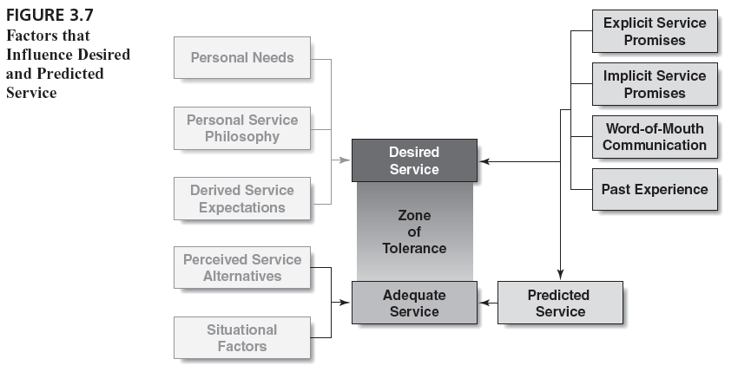
Factors That Influence Desired and Predicted Service
3-46

Slide 47
Frequently Asked Questions About Customer Expectations
What does a service marketer do if customer expectations are “unrealistic”?
Should a company try to delight the customer?
How does a company exceed customers’ service expectations?
Do customers’ service expectations continually escalate?
How does a service company stay ahead of competition in meeting customer expectations?
3-47

Slide 48
What does a service marketer do if customer expectations are “unrealistic”?
Customers’ main expectations of service are quite simple and basic: “Simply put, customers expect service companies to do what they are supposed to do”.
They expect fundamentals, not fanciness; performance, not empty promises.’
Customers want service to be delivered as promised. They want planes to take off on time, hotel rooms to be clean, food to be hot and service providers to show up when scheduled.
3-48

Slide 49
Should a company try to delight the customer?
Management consultants urge service companies to ‘delight’ customers to gain a competitive edge.
Delighting customers may seem like a good idea, but this level of service provision comes with extra effort and cost to the firm.
Therefore, the benefits of providing delight must be weighed.
Among the considerations are the staying power and competitive implications of delight.
If a competitor can easily copy the delight strategy, however, neither firm benefits (although the consumer does!), and all firms may be hurt because their costs increase and profits erode.
3-49

Slide 50
How does a company exceed customers’ service expectations?
First, it is essential to recognize that exceeding customer expectations of the basics is virtually impossible. Honouring promises – having the reserved room available, meeting deadlines, showing up for meetings, delivering the core service – is what the company is supposed to do.
Another way to exceed expectations is to deliberately under-promise the service to increase the likelihood of exceeding customer expectations. The strategy is to under-promise and over deliver.
A final way to exceed expectations without raising them in the future is to position unusual service as unique rather than the standard. For example, a restaurant may offer customers a free dessert by claimimg that the chef is trying out some new recipes/creations.
3-50

Slide 51
Do customer service expectations continually escalate?
In a highly competitive and rapidly changing industry, expectations can thus rise quickly.
For this reason companies need continually to monitor adequate service expectations – the more turbulent the industry, the more frequent the monitoring needed.
3-51

Slide 52
How does a service company stay ahead of competition in meeting customer expectations?
If a company’s level of service is barely above the adequate service level to begin with, a competitor can quickly erode that advantage.
Companies currently performing in the region of competitive advantage must stay alert to the need for service increases to meet or beat competition.
To develop a true customer franchise – immutable customer loyalty – companies must not only consistently exceed the adequate service level but also reach the desired service level.
Exceptional service can intensify customers’ loyalty to a point at which they are impervious to competitive options.
3-52

Slide 53
Group Discussion
List five incidents in which a service company has exceeded your expectations. How did you react to the service? Did these incidents change the way you viewed subsequent interactions with the companies? In what way?
Intuitively, it would seem that managers would want their customers to have wide tolerance zones for service. But if customers do have these wide zones of tolerance for service, is it more difficult for firms with superior service to earn customer loyalty? Would superior service firms be better off to attempt to narrow customers’ tolerance zones to reduce the competitive appeal of mediocre providers? Should service marketers delight their customers?
3-53

