Slide 1
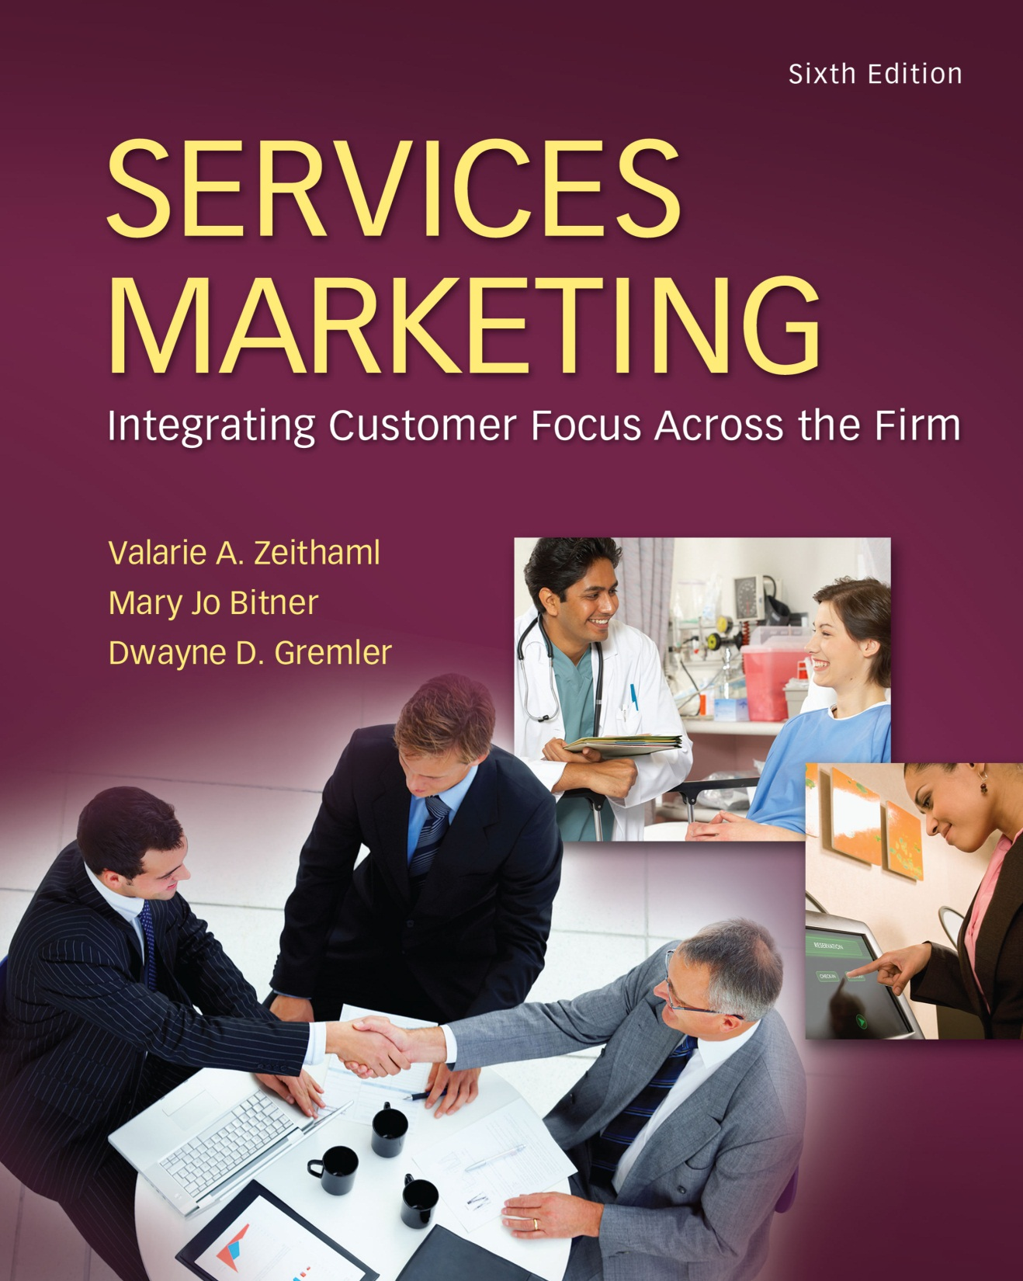
McGraw-Hill/Irwin
Copyright © 2013 by The McGraw-Hill Companies, Inc. All rights reserved.

Slide 2
Objectives for Chapter 4: Consumer Perceptions of Service
Provide a solid basis for understanding what influences customer perceptions of service and the relationships among customer satisfaction, service quality, and individual service encounters.
Demonstrate the importance of customer satisfaction—what it is, the factors that influence it, and the significant outcomes resulting from it.
Develop critical knowledge of service quality and its five key dimensions: reliability, responsiveness, empathy, assurance, and tangibles.
Show that service encounters, or the “moments of truth” are the essential building blocks from which customers form their perceptions.
4-2

Slide 3
Customer Perceptions of Service
Chapter
4
Customer Perceptions
Customer Satisfaction
Service Quality
Service Encounters: The Building Blocks for Customer Perceptions
4-3

Slide 4
The customer is . . .
Anyone who receives the company’s services, including:
external customers (outside the organization, business customers, suppliers, partners, end consumers)
internal customers (inside the organization, e.g., other departments, fellow employees)
4-4

Slide 5
Customer Perceptions
Chapter
4
In consumer behaviour, however, perception refers to much more than just the biological use of our sense organs.
It includes the way stimuli are interacted and integrated by the consumer.
Walters et al (1989) expand on the definition by stating that every perception involves a person who interprets through the senses some thing, event, or relation which may be designated as the percept.
4-5

Slide 6
Customer Satisfaction
Chapter
4
Significant differences in the definition of satisfaction, all the definitions share some common elements. When examined as a whole, three general components can be identified:
1) consumer satisfaction is a response (emotional or cognitive);
2) the response pertains to a particular focus (expectations, product, consumption experience, etc.); and
3) the response occurs at a particular time (after consumption, after choice, based on accumulated experience, etc).
4-6

Slide 7
Service Quality
Chapter
4
Quality is defined by the customer.
A technically perfect service that does not meet customers' expectations will fail.
When a service provider knows how consumers evaluate the quality of its service, it will be more able to influence these evaluations in a desired direction and to relate a service idea to customer benefits.
Nowadays, the marketing key is customer service, and the main competitive advantage is quality.
4-7

Slide 8
Service Encounters: The Building Blocks for Customer Perceptions
Service encounters (the customer-seller interaction at the point of sale).
Employees’ attitudes and their behaviour at the service encounter can positively or negatively influence customers’ perceptions of service quality.
It is important that companies focus their resources on ensuring that such service encounters are delivered in a reliable and consistent manner.
4-8

Slide 9
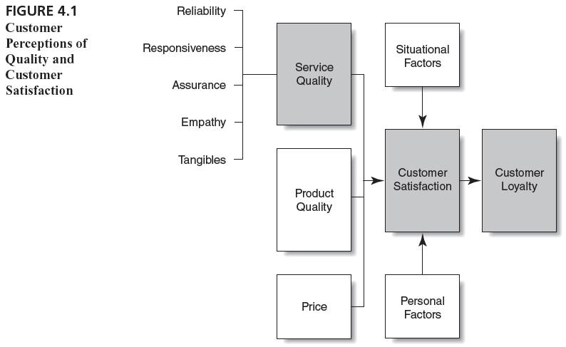
Customer Perceptions of Quality and Customer Satisfaction
4-9

Slide 10
Customer Perceptions of Quality and Customer Satisfaction
Service quality of a health club is judged on attributes such as equipment availability, equipment performance when needed, responsiveness of the staff in regards to customer needs, skilled trainers, well maintained facilities.
Satisfaction of health club influenced by perceptions of service quality and perception of product quality, the price of membership, personal factor such as customer’s emotional state, uncontrollable factors such as weather conditions, experiences driving to and from the health club.
4-10

Slide 11
Transaction Vs Cumulative Perceptions
Cumulative satisfaction recognizes that customers rely on their entire experience when forming intentions and making repurchase decisions.
Thus, one advantage of cumulative evaluations is that they should better predict customers’ intentions and behaviour.
4-11

Slide 12
Transaction Vs Cumulative Perceptions
Satisfaction and behavioral intentions for vehicle owners 3 to 4 months after purchase of the vehicle (initial consumption period) and 21 months later (later consumption period) using more open (cumulative) evaluations.
Researchers found that service satisfaction has a greater impact on intentions earlier in the consumption history, whereas product satisfaction has a greater impact later on.
4-12

Slide 13
Factors Influencing Customer Satisfaction
Product quality
Service quality
Price
Specific product or service features
Consumer emotions
Attributions for service success or failure
Perceptions of equity or fairness
Other consumers, family members, and coworkers
Personal factors
Situational factors
4-13

Slide 14
EQUITY, SATISFACTION, AND LOYALTY
Oliver (1997) defines equity as a “fairness, rightness, or deservingness comparison to other entities, whether real or imaginary, individual or collective, person or nonperson” (p. 196).
Equity is the customer’s evaluation of what is fair or right based on a comparison of outcomes relative to inputs.
Equity, in turn, affects the customer’s overall evaluation of the product or service provider, or customer satisfaction.
4-14

Slide 15
Outcomes of Customer Satisfaction
Increased customer loyalty
Positive word-of-mouth communications
Increased revenues
Increased return to shareholders
4-15

Slide 16
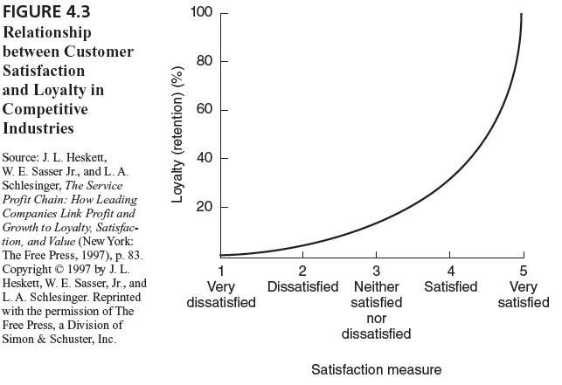
Relationship between Customer Satisfaction and Loyalty in Competitive Industries
4-16

Slide 17
Relationship between Customer Satisfaction and Loyalty
This relationship particularly strong when customer are very satisfied.
The firm need to aim more than satisfy or even delight their customers.
Xerox; Enterprise Rent-A-Car; TARP worldwide inc.
4-17

Slide 18
What is Service Quality? The Customer Gap
Expected Service
Customer gap
Perceived Service
Service quality is the customer’s judgment of overall excellence of the service provided in relation to the quality that was expected.
4-18

Slide 19
Service Quality
The customer’s judgment of overall excellence of the service provided in relation to the quality that was expected.
Service quality assessments are formed on judgments of:
outcome quality
interaction quality
physical environment quality
4-19

Slide 20
Service Quality
Restaurant’s customer will judge the service on his perceptions of the meal (Technical Outcome Quality).
How the meal was served and how the employees interacted with her (Interaction quality).
The décor and surrounding (Physical environment quality).
As the definition of service marketing:
Activities, benefits and satisfactions, which are offered for sale or are provided in connection with the sale of goods” (American Marketing Association, Committee of Definitions 1960, p. 21).
4-20

Slide 21
The Five Dimensions of Service Quality
Reliability
Ability to perform the promised service dependably and accurately.
Knowledge and courtesy of employees and their ability to inspire trust and confidence.
Physical facilities, equipment, and appearance of personnel.
Caring, individualized attention the firm provides its customers.
Willingness to help customers and provide prompt service.
Assurance
Tangibles
Empathy
Responsiveness
4-21

Slide 22
The Five Dimensions of Service Quality
RELIABILITY:
Should do things by the time they promise.
When customers have problems, they should be sympathetic and reassuring.
Should be dependable.
Should provide their services at the time they promise Should keep accurate records.
4-22

Slide 23
The Five Dimensions of Service Quality
Assurance:
Customers should be able to trust employees
Customers should feel safe in their transactions with these stores' employees
The employees should be polite
Employees should get adequate support to do their jobs well
4-23

Slide 24
The Five Dimensions of Service Quality
Tangible:
Should have up-to-date equipment
Physical facilities should be visually appealing
Employees should be well dressed and appear neat
Appearance of physical facilities should be in keeping with the type of services
4-24

Slide 25
The Five Dimensions of Service Quality
Empathy:
Company should give customers individual attention.
Employees need to give customers personal attention.
Employees need to know what the needs of their Customers Employees have to work on customers' best interests at heart.
Operating hours convenient to all customers.
4-25

Slide 26
The Five Dimensions of Service Quality
Responsiveness:
Should be expected to tell customers when services will be performed
Customers to expect prompt service
Employees always have to be willing to help customers is To respond to requests promptly
4-26

Slide 27
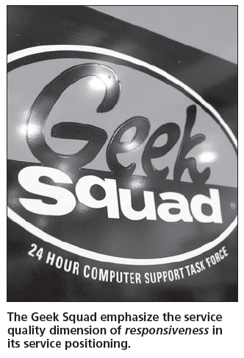
Geek Squad’s Focus on Responsiveness
4-27

Slide 28
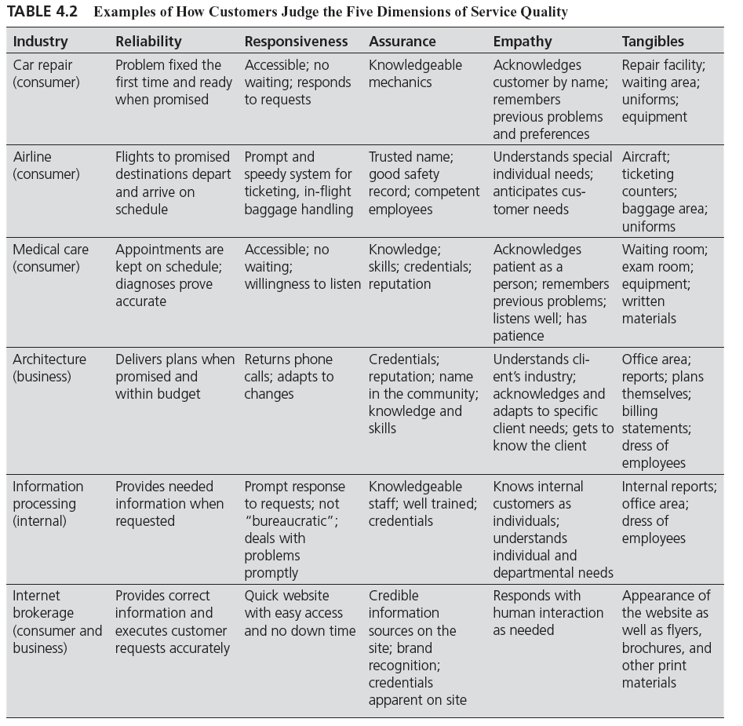
How Customers Judge the Five Dimensions of Service Quality
4-28

Slide 29
E-Service Quality
Is the extent to which a website facilitates efficient and effective shopping, purchasing and delivery.
Efficiency: The ease and speed of accessing and using the site.
Fulfilment: Order delivery and item availability are fulfilled.
System Availability: The correct technical functioning of the site.
Privacy: To which the site is safe and protects customer information.
4-29

Slide 30
E-Service Quality
Three dimensions of service recovery under E-service quality:
Responsiveness: The effective handling of problems and returns through the sites.
Compensation: The degree to which the site compensates customers problems.
Contact: The availability of assistance through telephone or online representative.
4-30

Slide 31
The Service Encounter
is the “moment of truth” : occurs any time the customer interacts with the firm
can potentially be critical in determining customer satisfaction and loyalty
types of encounters:
remote encounters, phone encounters, face-to-face encounters
is an opportunity to:
build trust
reinforce quality
build brand identity
increase loyalty
4-31

Slide 32
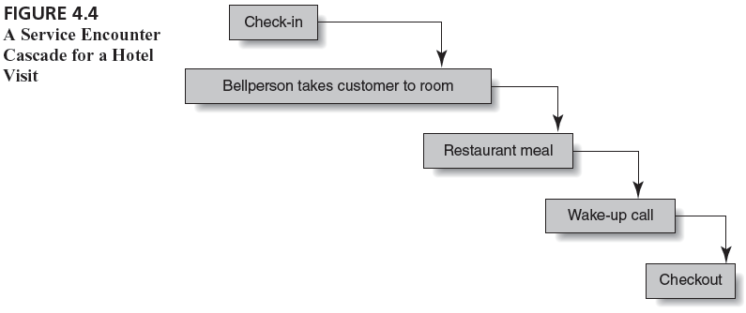
A Service Encounter Cascade for a Hotel Visit
4-32

Slide 33
A Service Encounter Cascade for an Industrial Purchase
Sales Call
Delivery and Installation
Servicing
Ordering Supplies
Billing
4-33

Slide 34
Service Encounters: An Opportunity to Build Satisfaction and Quality
4-34

Slide 35
The Service Encounter
Remote Encounter:
Occur without any direct human contact. Such as ATM system.
Technology –mediated encounters:
Frequent type of encounter between an end-customer and the firm occurs over the telephone or via texting, live chats or other platform.
Face-to-face encounter:
Encounter that occurs between an employee and a customer in direct personal contact. At Mayo Clinic, IBM.
4-35

Slide 36
Common Themes in Critical: Source of customer satisfaction/dissatisfaction in memorable Service Encounters.
Recovery (After Failure):
Adaptability:
employee response
to service delivery
system failure
employee response
to customer needs
and requests
Coping:
Spontaneity:
employee response
to problem customers
unprompted and
unsolicited employee
actions and attitudes
4-36

Slide 37
Common Themes in Critical: Source of customer satisfaction/dissatisfaction in memorable Service Encounters.
The first theme includes all incidents in which there has been a failure of the service delivery system and an employee is required to respond in some way to consumer complaints and disappointment.
The second theme underlying the service encounter in how adaptable the service delivery system is when the customer has special needs or requests that place demand on process.
The third theme reflect employee spontaneity in delivering memorable good or poor service. Like Special attention, being treated like royalty.
ROUDENESS, STEALING, DISCRIMINATION, IGNORING THE CUSTOMERS.

Slide 38
Common Themes in Critical: Source of customer satisfaction/dissatisfaction in memorable Service Encounters.
Employees described many incidents in which customers were the cause of their own dissatisfaction. Such customers were basically uncooperative – that is, unwilling to cooperate with the service provider.
The term Coping is used to describe these incidents because coping is the behaviour generally required of employees to handle problem customer encounters.

Slide 39
Recovery
4-39

Slide 40
Adaptability
4-40

Slide 41
Spontaneity
4-41

Slide 42
Coping
4-42

Slide 43
Technology-Based Service Encounter
Involve customers interacting with Internet-based services, automated phone services, kiosk services and services delivered via DVD or Video technology.
The system referred to as Self-service Technologies (SSTs) as customer essentially provides his or her own service.
4-43

Slide 44
Technology-Based Service Encounters
Themes for satisfying SSTs
The technology solved an intensified need
The technology was better than the alternative
The technology did its job
Themes for dissatisfying SSTs
The technology itself failed
The process failed
The technology was poorly designed
The customer did not use the technology properly
4-44

Slide 45
Exercise to Identify Service Attributes
In groups of five, choose a services industry and spend 10 minutes brainstorming specific requirements of customers in each of the five service quality dimensions. Be certain the requirements reflect the customer’s point of view.
Reliability:
Assurance:
Tangibles:
Empathy:
Responsiveness:
4-45

