Slide 1
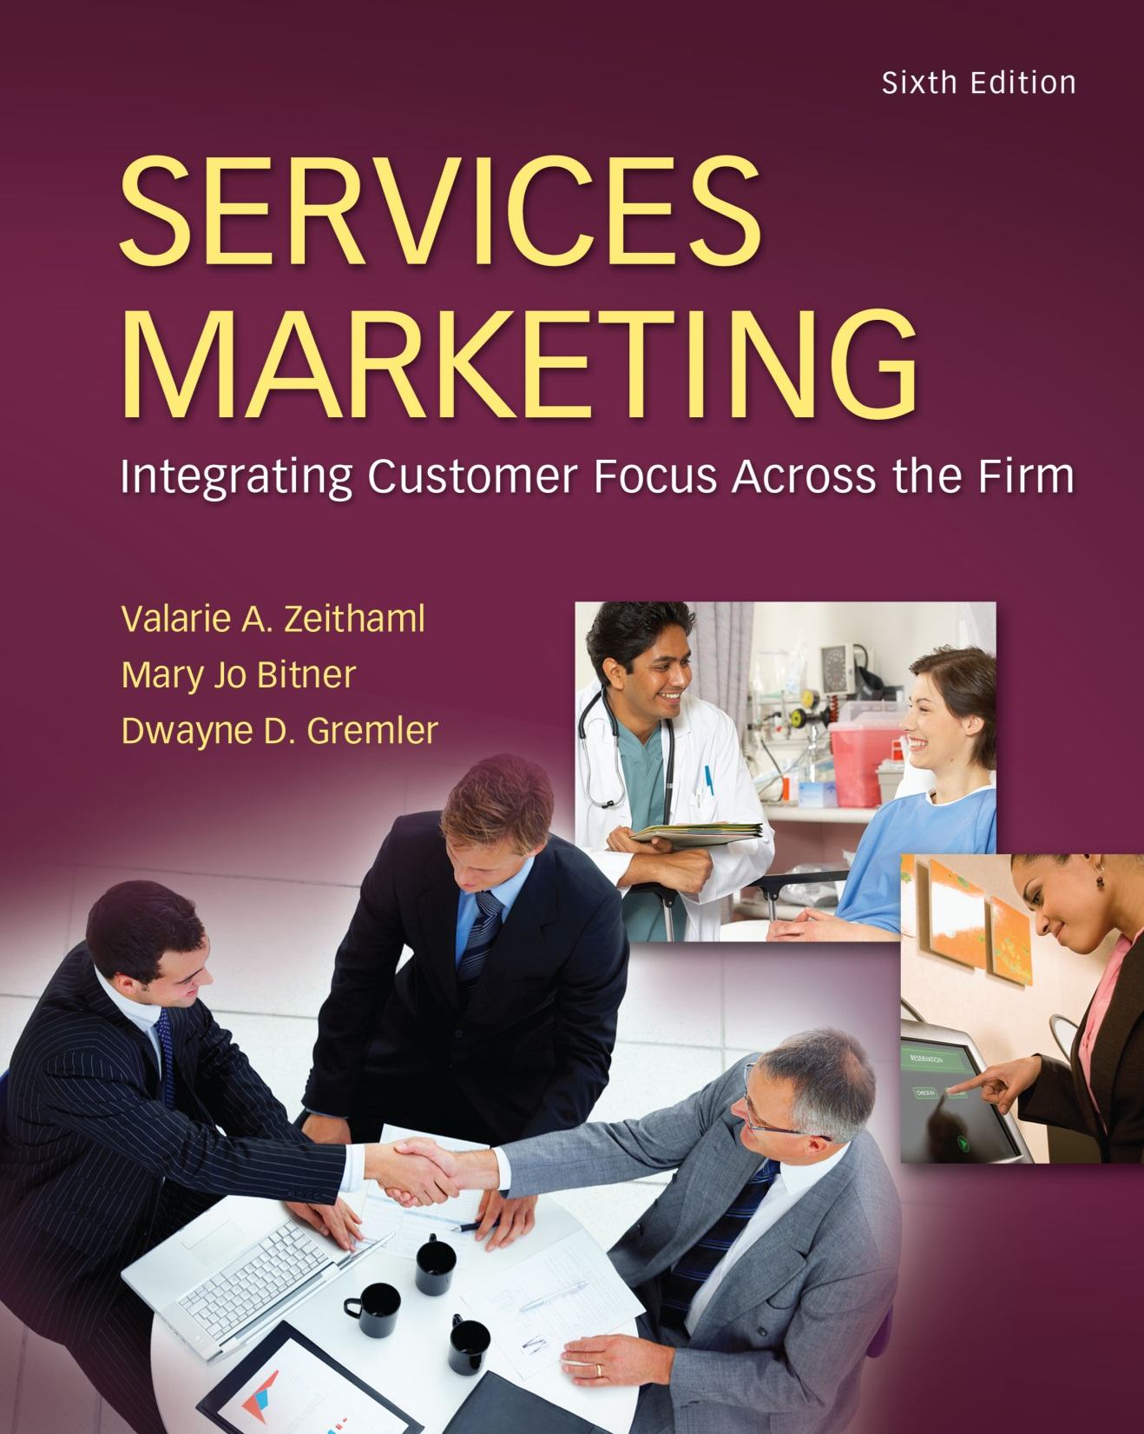
McGraw-Hill/Irwin
Copyright © 2013 by The McGraw-Hill Companies, Inc. All rights reserved.

Slide 2
Part 3
UNDERSTANDING CUSTOMER REQUIREMENTS
5-2

Slide 3
Provider Gap 1: The Listening Gap
CUSTOMER
Expected Service
COMPANY
Company Perceptions of Customer Expectations
5-3

Slide 4
Provider Gap 1: The Listening Gap
Not knowing what customers expect is one of the root causes of not delivering to customer expectation.
The listening Gap: (Customer expectations of service – Company understanding of those expectation)
So our objective is to link between the customer and the company.
As what customers expect is not always the same as what companies believe they expect.
We understand that companies listen to customer through research

Slide 5
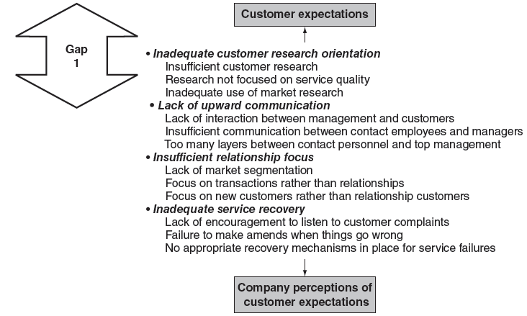
Key Factors Leading to Provider Gap 1
5-5

Slide 6
Listening to Customers through Research
Chapter
5
Using Customer Research to Understand Customer Expectations
Elements in an Effective Service Marketing Research Program
Analyzing and Interpreting Customer Research Findings
Using Marketing Research Information
Upward Communication
5-6

Slide 7
Research Objectives for services
The first steps in designing service marketing research are the defining problem and research objectives.
Does the company want to know how customers view the service provided by the company?
What customers want from the company five years from now?
To answer those questions managers require different kinds of research strategy.
So research objectives thus translate into action questions.
5-7

Slide 8
Common Research Objectives for Services
To discover customer requirements or expectations for service.
To monitor and track service performance.
To assess overall company performance compared with that of competition.
To assess gaps between customer expectations and perceptions.
To identify dissatisfied customers, so that service recovery can be attempted.
To gauge effectiveness of changes in service delivery.
To appraise the service performance of individuals and teams for evaluation, recognition, and rewards.
To determine customer expectations for a new service.
To monitor changing customer expectations in an industry.
To forecast future expectations of customers.
Read page 124 to 125
5-8

Slide 9
Criteria for an Effective Service Research Program
Includes both qualitative and quantitative research
Includes both expectations and perceptions of customers
Balances the cost of the research and the value of the information
Includes statistical validity when necessary
Measures priorities or importance of attributes
Occurs with appropriate frequency
Includes measures of loyalty, behavioral intentions, or actual behavior
5-9

Slide 10
Includes both qualitative and quantitative research
Qualitative research : Exploratory, preliminary, and are conducted to clarify problem definition, prepare for more formal research or gain insight when more formal research is not necessary.
The result of qualitative research play a major role in designing quantitative research.
Quantitative Research: in marketing is designed to describe the nature, attributes, or behaviors of customers empirically and test specific hypotheses that a service marketer wants to examine.
5-10

Slide 11
Includes both expectations and perceptions of customers
A measurement program that captures only perceptions of service is missing a critical part of service quality equation.
Companies need to incorporate measures of customer expectations.
So understanding the customer’s requirement that matter for them through qualitative and quantitative research may highly desirable.
Assessing customer expectations and compares these with perception levels, usually by calculating the gap between expectations and perceptions.
5-11

Slide 12
Balances the cost of the research and the value of the information
One cost is monetary, including direct cost to consumer research companies, payments to respondents, and internal company cost incurred by employees collecting the information.
Time costs
5-12

Slide 13
Includes statistical validity when necessary
Carefully control of sampling bias and statistical validity.
Not all forms of research have statistical validity, and not all forms need it.
Most forms of qualitative research, for example, do not possess statistical validity.
5-13

Slide 14
Measures priorities or importance of attributes
One of the most common mistakes manager make in trying to improve service is spending resources on the wrong initiatives.
Therefore research must documented the priorities of customers’
5-14

Slide 15
Occurs with appropriate Frequency
A single study of service provides only a “ Snapshot”
“Ongoing Research”
5-15

Slide 16
Includes Measures of Loyalty, Behavioral Intentions or Behavior
Measuring the positive and negative consequences of service quality along with overall satisfaction or service quality scores.
Understanding behavioral intentions may let you to know the willingness of the customers to recommend the services to others and repurchase intent.
Positive behavioral intention: recommending company to others, remaining loyal, spending more with the company etc.
Negative behavioral intention: saying negative things to others, doing less business with the company, switching to another company etc.
5-16

Slide 17
Elements in an Effective Customer Research Program for Services
Complaint Solicitation : Good service organizations take complaints seriously.
Not only do they listen to complaints-they also seek complaints as communication about what can be done to improve their services & their service employees.
Firms that use complaints as research & document them, then use the information to identify dissatisfied customers, correct individual problems where possible, and identify common service points
5-17

Slide 18
Elements in an Effective Customer Research Program for Services
Critical incident technique (CIT) is a well proven qualitative research approach that offers a practical step-by-step approach to collecting and analysing information about human activities and their significance to the people involved. It is capable of yielding rich, contextualized data that reflect real-life experiences.
Relationship surveys are there to investigate a customer’s loyalty to a company/brand. These types of surveys ask customers to consider the overall experience and satisfaction they have with a company and are typically carried out at regular intervals (e.g., quarterly, half-yearly or yearly).
5-18

Slide 19
Elements in an Effective Customer Research Program for Services
Post-transaction surveys: in most cases, are only conducted after you have a functioning relationship survey. This is because the results of a relationship survey should help determine the touch points that need to be surveyed transactionally.
“Which touch points do customers choose the most as the reason for their score, in the relationship survey?”
This question should guide your transactional survey process.
5-19

Slide 20
Elements in an Effective Customer Research Program for Services
Market-oriented ethnography : helps companies understand the consumer in terms of cultural trends, lifestyle factors, attitudes and how social context influences product selection and usage.
The term market-oriented ethnography refers to an ethnographic focus on the behaviour of people constituting a market for a product or service
5-20

Slide 21
Elements in an Effective Customer Research Program for Services
Complaint solicitation
To identify and attend to dissatisfied customers
Critical incident studies
To identify “best” practices” at transaction level
Relationship surveys
To monitor and track service performance
To identify common service failure points
To identify customer requirements as input for quantitative studies
To identify common service failure points
To identify systemic strengths and weaknesses in customer-contact services
To assess overall company performance compared with that of competition
To determine links between satisfaction and behavioral intentions
To assess gaps between customer expectations and perceptions
Posttransaction surveys
To obtain immediate feedback on performance of service transactions
To measure effectiveness of changes in service delivery
To assess service performance of individuals and teams
To use as input for process improvements; to identify common service failure points
Social media
To identify/attend to dissatisfied customers
To encourage word of mouth
To measure the impact of other advertising
5-21

Slide 22
Elements in an Effective Customer Research Program for Services (continued)
Market-oriented ethnography
To research customers in natural settings
Mystery shopping
To measure individual employee performance for evaluation, recognition, or rewards
Customer panels
To monitor changing customer expectations
To study customers from other cultures in an unbiased way
To identify systemic strengths and weaknesses in customer-contact services
To provide a forum for customers to suggest and evaluate new service ideas
Lost customer research
To identify reasons for customer defection
To assess gaps between customer expectations and perceptions
Future expectations research
To forecast future expectations of customers
To develop and test new service ideas
5-22

Slide 23
Portfolio of Services Research:
Research Is NOT Just Surveys!
5-23

Slide 24
Common means for answering questions
Ask customers directly
mail, phone, face-to-face, online
one-on-one, in groups, formal/informal
Observing customers
anthropological tools, qualitative depth
Get information from employees and front line service providers
Database marketing research
use customer information files
“capture” behavior through data analysis
5-24

Slide 25
Sample Questions for Critical Incident Studies
Think of a time when, as a customer, you had a particularly satisfying (dissatisfying) interaction with an employee of ______________.
When did the incident happen?
What specific circumstances led up to this situation?
Exactly what was said and done?
What resulted that made you feel the interaction was satisfying (dissatisfying)?
5-25

Slide 26
SERVQUAL Attributes
RELIABILITY
EMPATHY
Providing service as promised
Dependability in handling customers’ service problems
Performing services right the first time
Providing services at the promised time
Maintaining error-free records
Giving customers individual attention
Employees who deal with customers in a caring fashion
Having the customer’s best interest at heart
Employees who understand the needs of their customers
Convenient business hours
RESPONSIVENESS
Keeping customers informed as to when services will be performed
Prompt service to customers
Willingness to help customers
Readiness to respond to customers’ requests
TANGIBLES
Modern equipment
Visually appealing facilities
Employees who have a neat, professional appearance
Visually appealing materials associated with the service
ASSURANCE
Employees who instill confidence in customers
Making customers feel safe in their transactions
Employees who are consistently courteous
Employees who have the knowledge to answer customer questions
5-26

Slide 27
Analyzing and Interpreting customer research findings
Depicting marketing research findings graphically is a powerful way to communicate research information.
Zones of tolerance charts: Figure 5.2 plots customer service quality perceptions relative to customers’ zone of tolerance.
Perceptions of company performance indicated by the circles and zone of tolerance boxes are bounded on the top by the desired service score and on the bottom by the adequate service score.
5-27

Slide 28
Analyzing and Interpreting customer research findings
When the perception scores are within the boxes , the company is delivering service that is above customer’s minimum level of expectations.
When perception scores are below the boxes, the company’s service performance is lower than the minimum level and customers are dissatisfied.
5-28

Slide 29
Figure 5.2: Service Quality Perceptions Relative to Zones of Tolerance by Dimensions
9
8
7
6
5
4
3
2
1
0
O
O
O
O
O
Reliability Responsiveness Assurance Empathy Tangibles
O
Retail Chain
= Zone of Tolerance = Service Quality Perception
5-29

Slide 30
Analyzing and Interpreting customer research findings
Importance performance matrix:
This chart combines information about customer perceptions and importance ratings.
The shading of the chart indicates the area of highest leverage for service quality improvements-where importance is high and performance is low.
In this quadrant are the attributes that most need to be improved.
The lower two quadrant the attributes that are less important , some of which performed well and others poorly
5-30

Slide 31
Figure 5.3: Importance/Performance Matrix
HIGH
High
Leverage
●
●
●
●
●
●
●
●
●
Attributes to Improve
Attributes to Maintain
Attribute Importance
●
●
●
●
Low
Leverage
Attributes to Maintain
Attributes to De-emphasize
LOW
Attribute Performance
HIGH
5-31

Slide 32
Using Marketing Research Information
Understanding how to make the best use of research – to apply what has been learned to the business – is a key way to close the gap between customer expectations and management perceptions of customer expectations.
Use the research findings in a meaningful way.
To drive change or improvement.
5-32

Slide 33
Upward Communication
Upward communication is the flow of information from front line employees to managers, supervisors, and directors.
Upward communication keeps managers aware of how employees feel about their jobs, policies and procedures, and the business in general.
5-33

Slide 34
Upward Communication
Research for upward communication
Executive visits to customers
Executive or management listening to customers
Research on intermediate customers
Research on internal customers
Executive or management listening approaches to employees
Employee suggestions
Read page 147
5-34

Slide 35
Group Exercise
Imagine you have been hired to work an internship in a resort hotel in Hilton Head, South Carolina, for the summer. The manager learns you have had this service marketing class. In talking with you, she states that she feels the hotel is not always providing satisfactory service and may be performing in some areas below customer expectations. She stops talking and looks at you. Remember your future career may be riding on your answer. What do you tell her?
5-35

Slide 36
Group Exercise
The better answer should begin with a discussion of how a service marketing research program would be more appropriate than any single type of research.
The hotel will need a rich, multifaceted flow of information to close the gap between customer expectations and management perceptions of customer expectations. There should also be questions about how much time and money is available for the research project.
5-36

Slide 37
Group Exercise
The basic answer is to suggest the hotel, at a minimum, use complaint solicitation, critical incident studies and trailer calls to identify common service failure points. It will also need to look at its employees because they may believe the service provided is adequate when customers do not believe this to be true. The mystery shopper would be a good type of research to study employees.
Some students may also mention relationship surveys. Finally there should be a brief discussion of how this research study is useless if it is not used to drive change or create improvements.
5-37

