Slide 1
Data Collection Methods: Questionnaires
1

Slide 2
Questionnaire Design
Definition
A questionnaire is a pre-formulated, written set of questions to which the respondent records his answers
Steps
Determine the content of the questionnaire
Determine the form of response
Determine the wording of the questions
Determine the question sequence
Write cover letter

Slide 3
1. Questionnaire content
Framework
Need information for all constructs in framework
Measurement: Operationalizing
Objective construct:
1 element/items
=> 1 question
Subjective construct:
multiple elements/items
=> multiple questions

Slide 4
Questionnaire Content
The wording of the question and the level of sophistication of the language used are important. These are important because, if the respondent does not understand the words, obviously, he or she is not going to be able to respond to the questions.
An underground coal miner and a top business executive may need to be asked some of the same issues differently. Thus, using words that fit the level of sophistication of understanding of the respondent is necessary.
To take an extreme example, to assess the experienced quality of family life, a poorly educated farm hand may be first asked to list the activities he normally engages in when he gets home from work, and then asked to rate the extent of satisfaction gained from each of these activities.

Slide 5
Questionnaire content
An index of quality of family life might then be calculated by examining the family-related activities listed by the respondent.
With a business executive, on the other hand, the same concept can be tapped by asking the individual to rate his or her satisfaction to questions such as: Balance between work and family life; the impact of travelling on experiencing quality time with the family, and the like.

Slide 6
2. Response format
Closed vs. Open-ended questions
Closed questions
Helps respondents to make quick decisions
Helps researchers to code
Open-ended question
First: unbiased point of view
Final: additional insights
Complementary to closed question: for interpretation purpose

Slide 7
3. Question wording
Avoid double-barreled questions
Avoid ambiguous questions and words
Use of ordinary words
Avoid leading or biasing questions
Social desirability
Avoid recall depended questions

Slide 8
Question wording
Use positive and negative statements
Dresdner delivers high quality banking service
Dresdner has poor customer operational support
Avoid double negatives
Limit the length of the questions
Rules of thumb:
< 20 words
< one full line in print

Slide 9
Both positively and negatively worded questions need to be asked in the questionnaire so that the respondent does not mechanically answer the items without much mental engagement.
For example, if one question asks for the level of excitement that a particular advertisement evoked, another could ask the extent to which that same advertisement seemed irrelevant.
The questions are worded both positively and negatively, helps to enhance the attention span of the respondents who might otherwise respond mechanically.

Slide 10
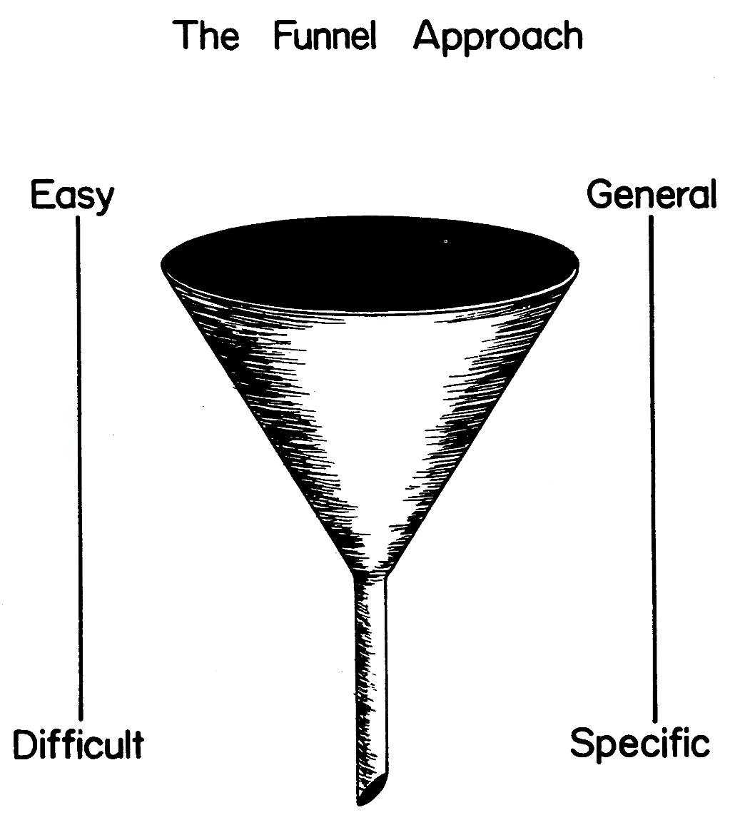
4. Question sequence
Personal and sensitive data at the end

Slide 11
5. Cover letter
The cover letter is the introductory page of the questionnaire
It includes:
Identification of the researcher
Motivation for respondents to fill it in
Confidentiality
Thanking of the respondent

Slide 12
Double barreled questions should be avoided. If one asks the question, “Do you value and manage a diverse workforce well”?, there may be no clear response given to the question because one may value a diverse workforce, but hardly know how to manage it! In such cases, it would be better to ask two separate questions rather than one.

Slide 13
Ambiguous questions should also be avoided. Questions such as “Do you discuss your work with the president regularly”? or “Do you go to the movies frequently”? are ambiguous, because the terms regularly and frequently are left open to the interpretation of each respondent.
One individual might discuss work with the president on a daily basis, and another every six months. Both are “regularly” (or at regular intervals) discussing work! But is this what the researcher is looking for?

Slide 14
Similarly, frequently going to the movies might mean one movie every week to one person, one movie every month to another, and three times a week to a third person! Since these terms are not defined, biased data will be procured from the respondents.

Slide 15
Recall dependent questions will also introduce biases. For example, not many people remember when exactly they started smoking, or why they quit a particular school and joined another when they were 10 years old.

Slide 16
Leading questions also result in biased responses because the interviewee might be led to believe that a particular type of answer is sought and might try to oblige the interviewer, even if the response is not what the individual believes to be true.
An example of a leading question is: Don’t you think that more women should be promoted to decision-making line positions in organizations? Such a question is likely to elicit the obvious response, “Surely, Yes”!

Slide 17
Loaded questions should also be avoided because of the emotionality it invokes, thus eliciting biased responses.
As an example: “Don’t you think that the L.A.P.D. is biased against blacks?” is a question with racial overtones which will bring forth emotional, rather than objective responses to the question.

Slide 18
Questions invoking social desirability will also produce biased responses.
An example would be to ask if anyone felt that workforce diversity is bad for the system.
In the context of the changing demographics of the workforce, even if some felt that diversity at the workplace is disastrous, they would tend not to disagree because it is not a socially acceptable response.

Slide 19
It is also important to avoid lengthy questions which might confuse the respondent and introduce several types of biases.
An example of a long question is: To what extent would asking for responses from different groups of employees, such as for instance, production, marketing, R & D, advertising, and sales, on such issues as the policy governing the organization, the organizational culture, staff discipline and other related matters, provide valid data to the president, to enable him to make some critical decisions on how to run the company effectively and efficiently?

Slide 20
Validity
If there is convergence or strong correlation among the data obtained from different data collection methods on the same variable, then one can establish convergent validity because the data converge even when collected by different methods. The same holds true when there is a strong and significant correlation between the data obtained on the same variable from different sources.

Slide 21
For instance, if employees’ performance is to be measured, it is better to go through the person’s records and evaluation forms of the superiors (in case more objective measures of output are not available). However, such records are usually confidential in nature and are not likely to be made accessible to the researcher.
Hence data will be sought from multiple sources–for example, from the subject, the co-workers, the immediate supervisor, other superiors, and perhaps even the subordinates.

